Slide 1
Gastric tumours
Dr. Arun R Nair
Dept. of PM

Slide 2
ADENOCARCINOMA
Gastric cancer is currently the fourth most common cancer found worldwide and the second leading cause of cancer related mortality.
The incidence increases with age (peak incidence 50–70 years), and it is rare under the age of 30 years.
The incidence in men is twice that in women.

Slide 3
Epidemiology and pathogenesis
There is a strong link between H. pylori infection and distal gastric cancer. (spiral shaped, -ve organism,secreate urease to chemical urea to ammonia)
H. pylori is recognized by the International Agency for Research in Cancer (IARC) as a Group 1 (definite) gastric carcinogen.
H. pylori infection causes chronic gastritis which eventually leads to
atrophic gastritis and premalignant intestinal metaplasia.
Epstein–Barr virus is detected in 2–16% of gastric cancers worldwide, but its role in aetiology is not well understood.

Slide 4

NORMAL GASTRIC MUCOSA
Helicobacter pylori infection
ACUTE GASTRITIS
Chronic active gastritis
Atrophic gastritis
Intestinal metaplasia
DYSPLASIA
ADVANCED GASTRIC CANCER

Slide 5
Dietary factors Diets high in salt probably increase the risk. Dietary nitrates can be converted into nitrosamines by bacteria at neutral pH, and nitrosamines are known to be carcinogenic. Nitrosamines are also present in the stomach of patients with achlorhydria, who have an increased cancer risk.
Smoking tobacco is associated with an increased incidence of stomach cancer.
Genetic abnormality. The commonest is a loss of heterozygosity (LOH) (is a cross chromosomal events that results in loss of the entire gene & surrounding chromosomal region) of tumour suppressor genes such as p53 (in 50% of cancers as well as in pre-cancerous states) and the APC (Adenomatous Polyposis Coli- suppressor gene) gene. Some rare families with diffuse gastric cancer have been shown to have mutations in the E-cadherin gene (CDH-1). ( Epithelial Cadherin gene or uvomorulin is a protine- tumor suppressor Gene)
There is a higher incidence of gastric cancer in blood group A patients.

Slide 6
First-degree relatives of patients with gastric cancer have two- to three-fold increased relative risk of developing the disease, but this may be environmental rather than inherited.
Pernicious anaemia carries a small increased risk of gastric carcinoma due to the accompanying atrophic gastritis.
There is an increased risk of gastric cancer after a partial gastrectomy (postoperative stomach) whether performed for a gastric or a duodenal ulcer, probably due to untreated H. pylori infection.

Slide 7
Early gastric cancer
Early gastric cancer is defined as a carcinoma that is confined to the mucosa or submucosa, regardless of the presence of lymph node metastases. It is associated with 5-year survival rates of approximately 90%, but many of these patients would have survived 5 years without treatment.

Slide 8
Pathology
There are two major types of gastric cancer:
Intestinal (type 1): with well-formed glandular structures (differentiated). The tumours are polypoid or ulcerating lesions with heaped-up, rolled edges. Intestinal metaplasia (change in form) is seen in the surrounding mucosa, often with H. pylori. This type is more likely to involve the distal stomach and occur in patients with atrophic gastritis. It has a strong environmental association

Slide 9
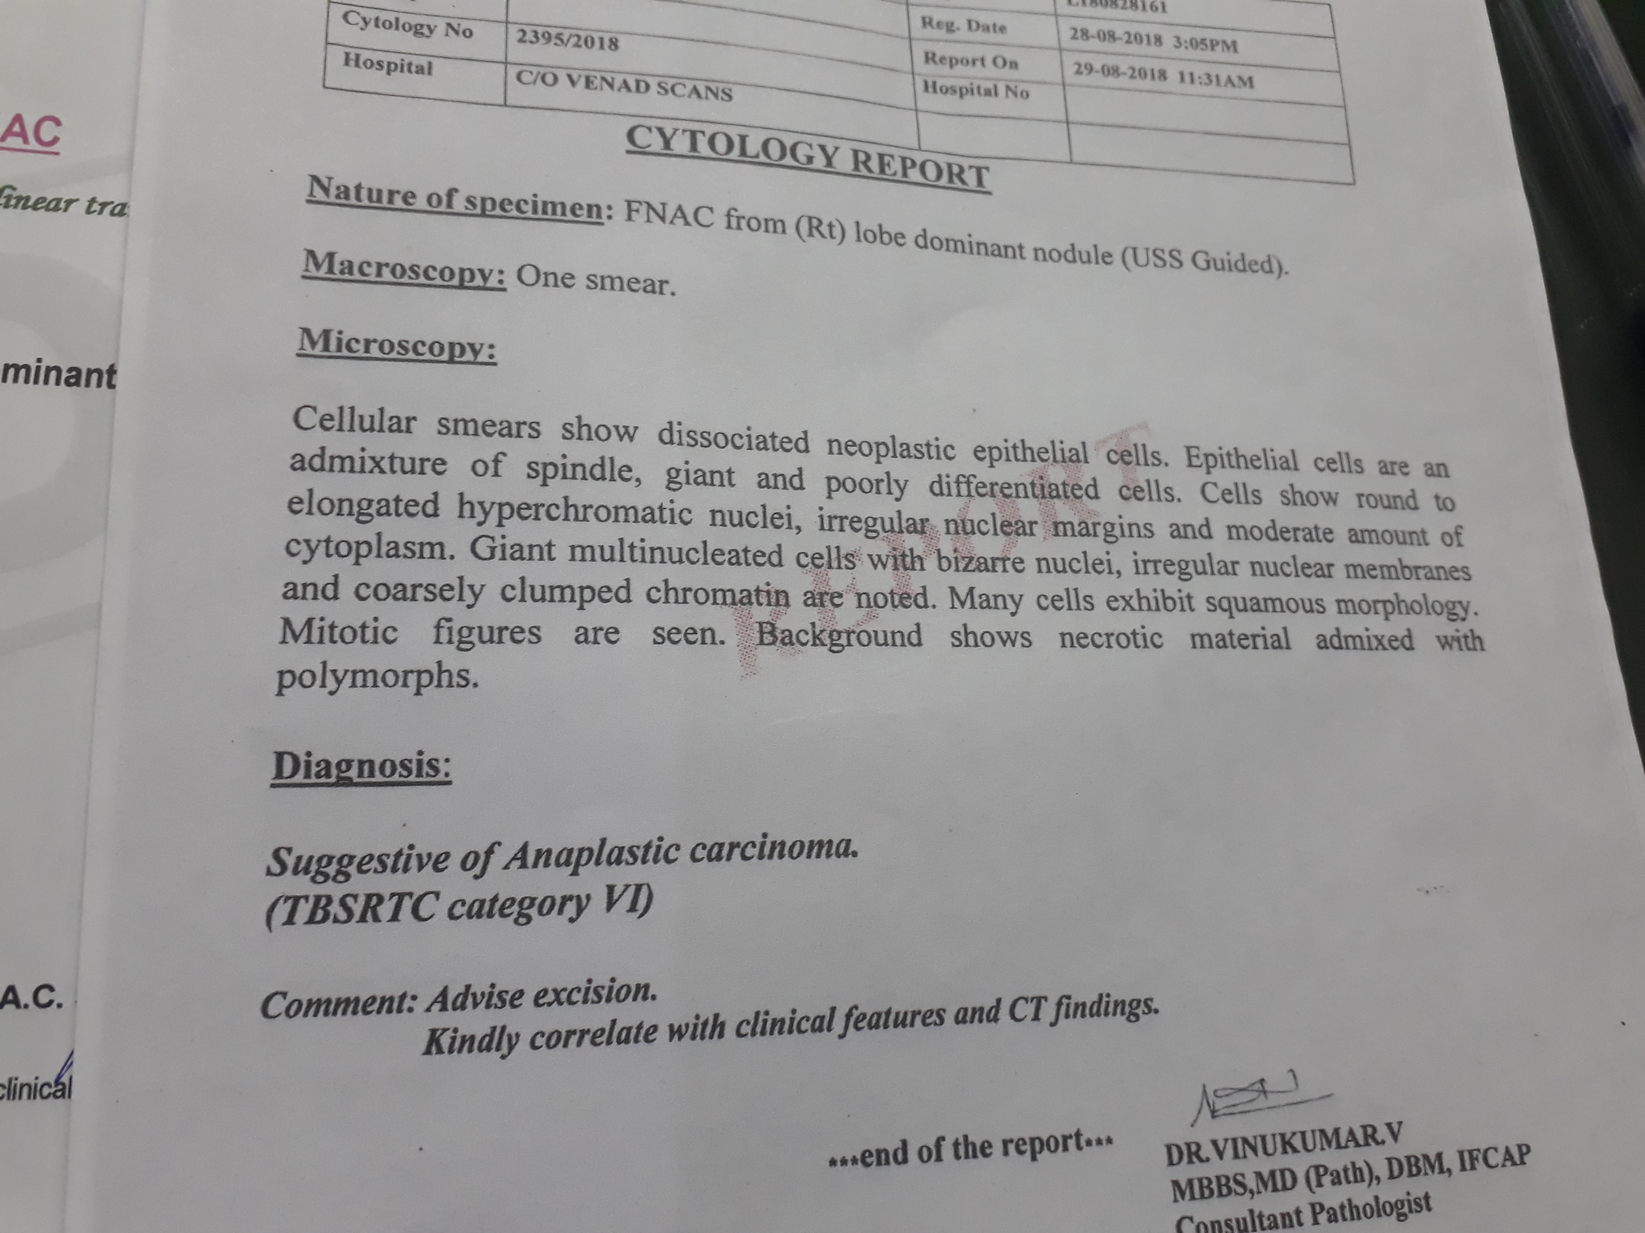

Slide 10
Diffuse (type 2): with poorly cohesive cells (undifferentiated) that tend to infiltrate the gastric wall, may involve any part of the stomach, especially the cardia, and have a worse prognosis than the intestinal type. Loss of expression of the cell adhesion molecule E-cadherin is the key event in the carcinogenesis of diffuse gastric cancers.
Unlike type 1 gastric cancers, type 2 cancers have similar frequencies in all geographic areas and occur in a younger population.

Slide 11
Clinical features
Symptoms
Most patients with carcinoma of the stomach have advanced disease at the time of presentation. The most common symptom of advanced disease is epigastric pain, indistinguishable from the pain of peptic ulcer disease; it may be relieved by food and antacids. The pain can vary in intensity, but may be constant and severe, and there may also be
nausea, anorexia and weight loss. Vomiting is frequent and can be severe if the tumour encroaches on the pylorus.
Dysphagia can occur with tumours involving the fundus. Gross haematemesis is unusual, but anaemia from occult blood loss is frequent..

Slide 12
No pattern of symptoms is suggestive of early gastric cancer.
Widely spreading submucosal gastric cancer causes diffuse thickening and rigidity of the stomach wall and is called ‘linitis plastica’.
Patients can present at a late stage with malignant ascites or jaundice due to liver involvement.
Metastases also occur in bone, brain and lung, producing appropriate symptoms

Slide 13
Signs
Weight loss is often the dominant feature.
Nearly 50% of patients have a palpable epigastric mass with abdominal tenderness.
A palpable lymph node is sometimes found in the supraclavicular fossa (Virchow’s node, usually on the left side) and metastases are present in up to one-third of patients at presentation.
This cancer is the most frequently associated with dermatomyositis and acanthosis nigricans.

Slide 14
Diagnosis
Gastroscopy .Gastroscopy is performed so that biopsies can be taken for histological assessment. Positive biopsies can be obtained in almost all cases of obvious carcinoma, but a negative biopsy does not necessarily rule out the diagnosis. For this reason, 8–10 biopsies should be taken from suspicious lesions. Superficial brushings for cytology further improve the diagnostic rate.

Slide 15
Staging
 CT scan of the chest and abdomen: CT with a gastric water load can demonstrate gastric wall thickening, lymphadenopathy and lung and liver secondaries, but has limited ability to determine the depth of local tumour invasion.
 Transabdominal ultrasound can demonstrate masses, gastric wall thickening, lymphadenopathy and liver secondaries.
 Endoscopic ultrasound is useful for local staging to demonstrate the depth of penetration of the cancer through the gastric wall and extension into local lymph
nodes. It complements CT and ultrasound but is most relevant to confirm a cancer is confined to the superficial mucosa, before endoscopic resection.
 Laparoscopy is useful in patients being considered for surgery to exclude serosal disease.
 PET and CT/PET can be helpful in further delineation of the cancer.

Slide 16
The TNM classification is used. The tumour grade (T) indicates depth of tumour invasion, N denotes the presence or absence of lymph nodes, M indicates presence or absence of metastases.
TNM classification is then combined into stage categories 0–4. At presentation, two-thirds of patients are at stage 3 or 4, i.e. advanced disease .The histological grade of the tumour also determines survival.

Slide 18
Treatment
As with all cancers, treatment is discussed with a multidisciplinary team. Early non-ulcerated mucosal lesions can be removed endoscopically by either endoscopic mucosal resection or endoscopic submucosal desection.
Surgery remains the most effective form of treatment if the patient is an operative candidate.

